Slide 1

Project Team | G-1220 | AI-Powered Quiz Generator - Quizzy
Date: 02-06-2026
Team Members
A.ANSHULA – 24BD1A05C1
ISHIKA SHETTY – 24BD1A668K
P.BHAVITHA – 24BD1A669C
P.LIKITHA – 24BD1A669B
P.RASHMITHA-24BD1A669D
Mentors
Ms. G.Swetha Goud

Slide 2
CONTENTS
Title Slide
Project Overview
Introduction
Requirement
Design
Development
Project Outcome
Conclusion
Thank you!

Slide 3
INTRODUCTION
Problem Statement
Students and teachers often spend a lot of time creating quizzes manually from notes, topics, PDFs, and online resources. Existing quiz tools may generate questions, but they often lack personalized feedback, progress tracking, revision support, and teacher-level insights..
Purpose
Develop an AI-powered web platform that automatically generates quizzes from topics, PDF files, and URLs. Quizzy helps students practice effectively with instant evaluation, explanations, flashcards, and progress analytics.
Objectives
Generate quizzes automatically from topics, PDFs, and URLs.
Provide instant scores, explanations, recommendations, and flashcards for revision.
Support students and teachers with dashboards, progress tracking, leaderboard ranking, and Brain Lab activities.

Slide 4
REQUIREMENT
Functional Requirements
Allow users to register, login, and access personalized quiz features.
Generate quizzes from topic input, uploaded PDF files, and web URLs.
Let users choose quiz settings such as difficulty, number of questions, question type, and timer.
Display quiz questions, collect answers, and evaluate responses instantly.
Provide scores, explanations, recommendations, flashcards, progress analytics, leaderboard, and teacher dashboard.
Non-Functional Requirements
Quiz generation and result evaluation should be fast, smooth, and user-friendly.
User data, quiz history, and progress should be stored securely in the database.
The interface should be clean, readable, and easy to navigate.
The system should handle invalid inputs, missing files, and API errors gracefully..

Slide 5
DESIGN
System Architecture
Frontend - Provides the user interface for login, quiz generation, quiz attempt, results, flashcards, dashboards, and Brain Lab activities.
Backend - Handles authentication, quiz requests, AI API communication, PDF/URL processing, quiz evaluation, and data flow.
Database - Stores user details, quiz history, scores, progress analytics, leaderboard data, and teacher dashboard records.
AI API - Generates quiz questions, explanations, recommendations, and learning support based on user input..
Tech Stack
Languages: HTML, CSS, JavaScript
Frontend: Vite, responsive web pages, interactive UI components
Backend: Node.js, Express.js
Database: MongoDB
AI/NLP: AI API, Natural Language Processing, PDF Parsing, URL Extraction
Deployment: Vercel for live demo

Slide 6
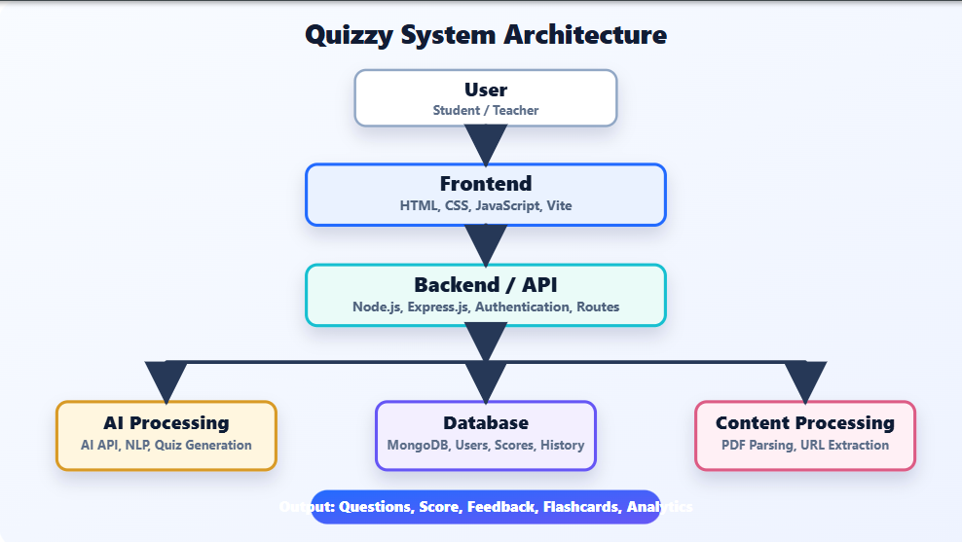
Architecture Diagram

Slide 7
DEVELOPMENT
Modules Implemented
Authentication Module - Login, registration, and user sessions.
Quiz Generation Module - Creates quizzes from topics, PDFs, and URLs.
Quiz Attempt and Result Module - Displays questions, evaluates answers, and shows scores.
Dashboard Module - Tracks user progress, attempts, accuracy, XP, and streaks.
Teacher Dashboard Module - Shows learner progress, topic signals, and quiz activity.
Brain Lab Module - Includes memory, reaction, and recall-based learning games.
Backend Workflow
User selects topic, PDF, or URL → Backend receives request → Content is processed → AI API generates quiz questions → Quiz is displayed to the user → Answers are evaluated → Score, feedback, flashcards, and recommendations are returned.
The backend manages authentication, quiz generation requests, AI API communication, result evaluation, user progress, leaderboard data, and teacher dashboard records.
Tools Used
HTML | CSS | JavaScript | Vite | Node.js | Express.js | MongoDB | AI API | NLP | PDF Parsing | URL Extraction | Vercel

Slide 8
PROJECT OUTCOME
Achievements
Developed a responsive AI-powered quiz generation platform for students and teachers.
Implemented quiz generation from topics, PDF files, and web URLs.
Added instant score evaluation with explanations, recommendations, flashcards, and progress analytics.
Built student dashboard, teacher dashboard, leaderboard, and Brain Lab activities.
Challenges Faced
Handling different input sources such as topic text, PDFs, and URLs.
Generating relevant quiz questions with clear explanations and correct answers.
Maintaining smooth responsiveness across mobile, tablet, laptop, and desktop screens.
Organizing multiple features without making the interface cluttered..
Future Enhancements
Add more advanced AI-based personalization for each learner.
Support more question types and subject-specific quiz templates.
Improve teacher analytics with downloadable reports.
Add multilingual quiz generation and voice-based quiz interaction.

Slide 9
CONCLUSION
Summary
Quizzy is an AI-powered quiz generation platform that makes learning and assessment faster, smarter, and more interactive. It converts topics, PDF files, and URLs into quizzes, provides instant evaluation, and supports students with explanations, flashcards, recommendations, progress analytics, and Brain Lab activities. It also helps teachers track learner performance through a dedicated dashboard.
Skills Learned
Full-stack web development using HTML, CSS, JavaScript, Node.js, Express.js, and MongoDB.
AI API integration for quiz generation, explanations, and learning recommendations.
PDF parsing, URL extraction, authentication, dashboard design, and responsive UI development.
Testing and improving the app for mobile, tablet, laptop, and desktop responsiveness.
Current Status: Functional web prototype completed with quiz generation, result evaluation, dashboards, flashcards, leaderboard, Brain Lab activities, and live demo access.
Next Step: Improve AI personalization, add more question formats, enhance teacher analytics, and prepare the system for wider deployment.

Slide 10
Thank you!

